Slide 1
Introduction to Digital Logic Design
Chapter -1

Slide 2
Introductory Concept
Explain the basic differences between digital and
analog quantities
Show how voltage levels are used to represent
digital quantities
Describe various parameters of a pulse waveform
such as rise time, fall time, pulse width, frequency,
period, and duty cycle
Explain the basic logic functions of NOT, AND,
and OR
Describe several types of logic operations and
explain their application in an example system

Slide 3
DIGITAL TECHNOLOGY
The term digital is derived from the way computer perform operations → by counting digits.
Today, digital tech is applied in a wide range of areas.
The tech has progressed from vacuum-tube to discrete transistors to complex ICs.

Slide 4
DIGITAL AND ANALOG QUANTITIES
Two categories of electronic circuits:
  Analog
  Digital
Analog quantity = continuous values
Digital quantity = a discrete set of values

Slide 5
ANALOG QUANTITY
Most things in nature → analog form
  Temperature, pressure, distance, etc
Smooth, continuous curve like this:
Temp
Time

Slide 6
DIGITAL QUANTITY
Sampled-value representation (quantization)
Each dot can be digitized as a digital code (consists of 1s and 0s)
Temp
Time

Slide 7
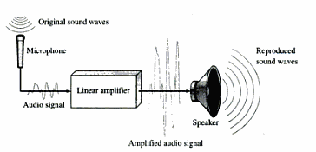
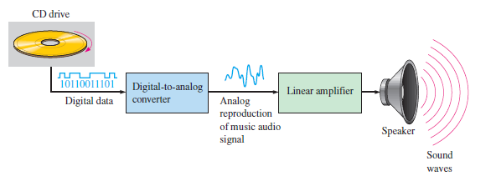

Slide 8
DIGITAL ADVANTAGES
Digital data can be processed and transmitted more efficiently and reliably than analog data.
Digital data has a great advantage when storage is necessary.
Music when converted to digital form can be stored more compactly and reproduced with great accuracy and clarity than analog.
Noise doesn’t effect digital data.

Slide 9
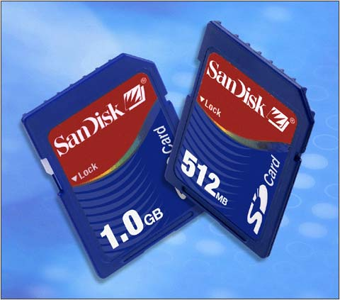
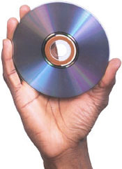
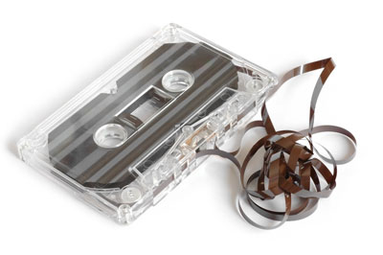
DIGITAL MUSIC
The media is very compact but higher-density (and counting):
  CDs
  Memory cards
No more bulky and noise media like cassette tape

Slide 10
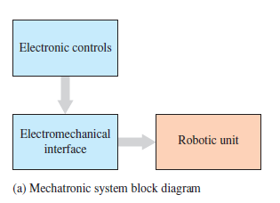
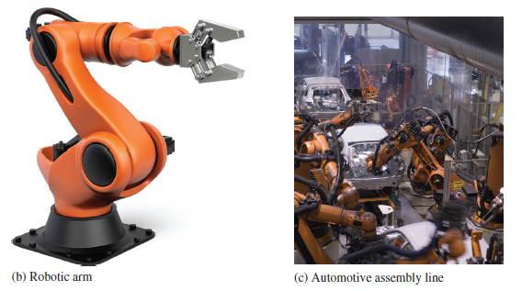
MECHATRONICS
Both digital and analog electronics are used in the control of various mechanical systems. The interdisciplinary field that comprises both mechanical and electronic components is known as mechatronics.
Mechatronic systems are found in homes, industry, and transportation. Most home appliances consist of both mechanical and electronic components. Electronics controls the operation of a washing machine in terms of water flow, temperature, and type of cycle.

Slide 11
Binary Digits,
Logic Levels, &
Digital Waveforms

Slide 12
BINARY DIGITS
Binary system (either 0 or 1)
  Bit (comes from binary digit)
Digital circuits:
  1 represents HIGH voltage
  0 represents LOW voltage
Groups of bits (combinations of 0s and 1s) are called codes
  Being used to represent numbers, letters, symbols, (i.e. ASCII code), instructions, and etc.

Slide 13
LOGIC LEVELS
The voltages used to represent a 1 and 0 are called logic levels.
  Ideally, there is only HIGH (1) and LOW (0).
  Practically, there must be thresholds to determine which one is HIGH or LOW or neither of them.
CMOS
  (2V to 3.3V → HIGH)
  (0V. To 0.8V → LOW)
V_{H(max)}
HIGH
(binary 1)
V_{H(min)}
Not allowed
V_{L(max)}
LOW
(binary 0)
V_{L(min)}

Slide 14
DIGITAL WAVEFORMS
Voltage levels that are changing back and forth between HIGH and LOW
(Ideal) pulse
At t₀ → leading edge, at t₁ → trailing edge
HIGH
HIGH
LOW
LOW
t₀
t₁
t₀
t₁
Positive-going pulse
Negative-going pulse

Slide 15
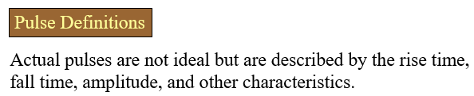
NON-IDEAL PULSE
90%
t_{w}
Amplitude
50%
Pulse width
10%
t_{r}
t_{f}
Rise time
Fall time

Slide 16
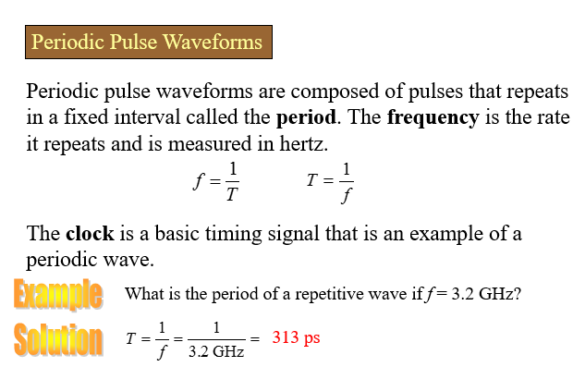

Slide 17
WAVEFORM CHARACTERISTICS
Waveforms = series of pulses (called pulse train)
  Periodic
    Period (T) = T₁ = T₂ = T₃ = … = T_{n}
    Frequency (f) = 1/T
  Nonperiodic
T₁
T₂
T₃

Slide 18
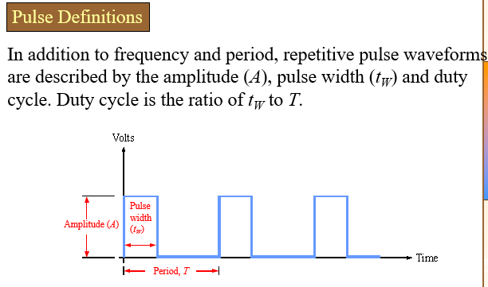

Slide 19
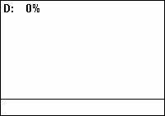
DUTY CYCLE
Ratio of the pulse width (t_{w}) to the period (T)
Duty cycle = ( t_{w} / T ) x 100%

Slide 20
EXAMPLE
From a portion of a periodic waveform (as shown) determine:
  Period
  Frequency
  Duty cycle
T
t_{w}
0
1
10
11
t (ms)

Slide 21

A DIGITAL WAVEFORM CARRIES BINARY INFORMATION
Binary information that is handled by digital systems appears as waveforms that represent sequences of bits. When the waveform is HIGH, a binary 1 is present; when the waveform is LOW, a binary 0 is present. Each bit in a sequence occupies a defined time interval called a bit time.
Bit time
1
clock
0
1
A
0
Bit sequence represented by waveform A
1
0
1
0
0
1
1
0
0
1
0
1

Slide 22
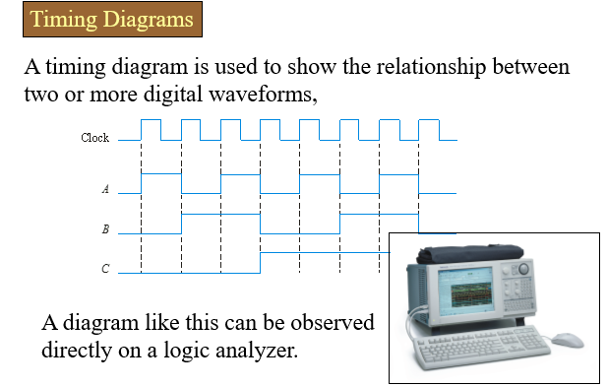

Slide 23
DATA TRANSFER
Data refers to groups of bits that convey some type of information. Binary data, which are represented by digital waveforms, must be transferred from one device to another within a digital system or from one system to another in order to accomplish a given purpose.
Binary data are transferred in two ways:
  Serial – bits are sent one bit at a time
  Parallel – all the bits in a group are sent out on separate lines at the same time (one line for each bit)
InfoNote :Universal Serial Bus (USB) is a serial bus standard for device interfacing. It was originally developed for the personal computer but has become widely used on many types of handheld and mobile devices. USB is expected to replace other serial and parallel ports. USB operated at 12 Mbps (million bits per second) when first introduced in 1995, but it now provides transmission speeds of up to 5 Gbps.

Slide 24
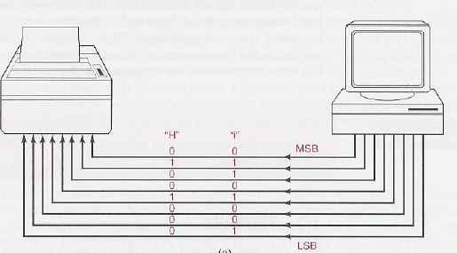
PARALLEL TRANSMISSION
All the bits in a group are sent out on separate lines at the same time. There is one line for each bit.
Advantage:
Parallel is Faster ( b/c all bits are transmitted simultaneously)
Disadvantage:
More lines are required

Slide 25
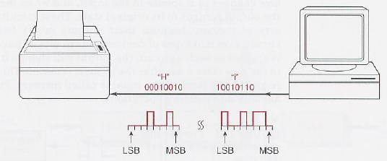
SERIES TRANSMISSION
One bit sent at a time along a single conductor. To transfer eight bits in series, it takes eight time intervals.
Advantage:
Only one line is required.
Disadvantage:
It takes longer time to transfer the data.

Slide 26
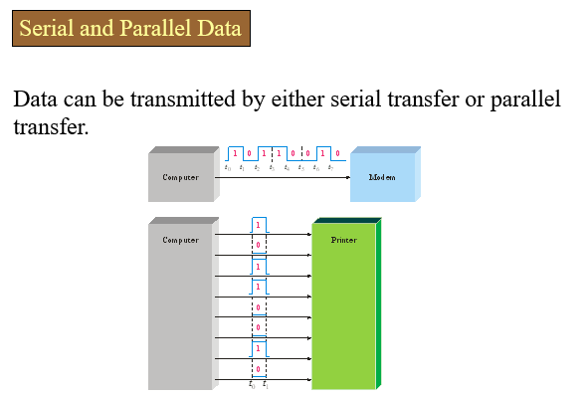

Slide 27

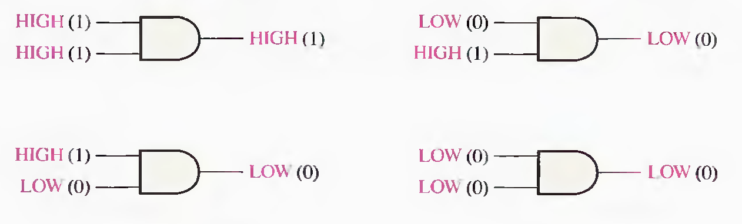
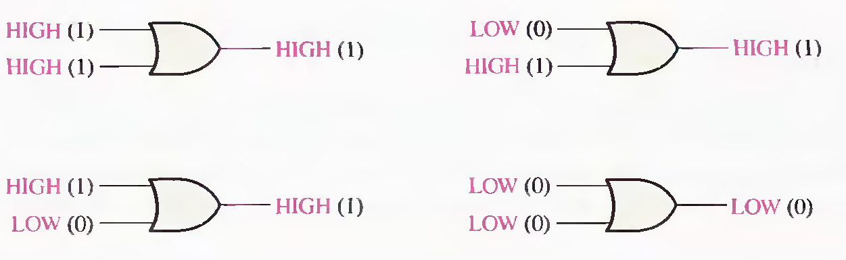
BASIC LOGIC OPERATIONS
NOT operation
AND operation
OR operation

Slide 28

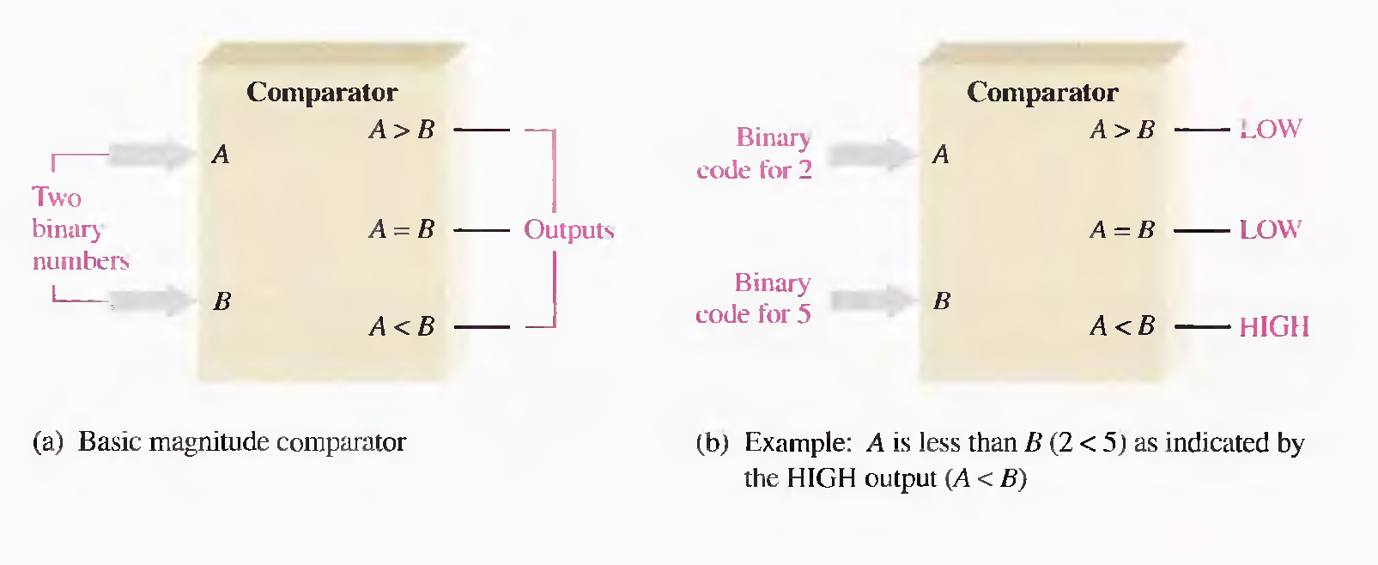
Introduction to the System Concept

Slide 29

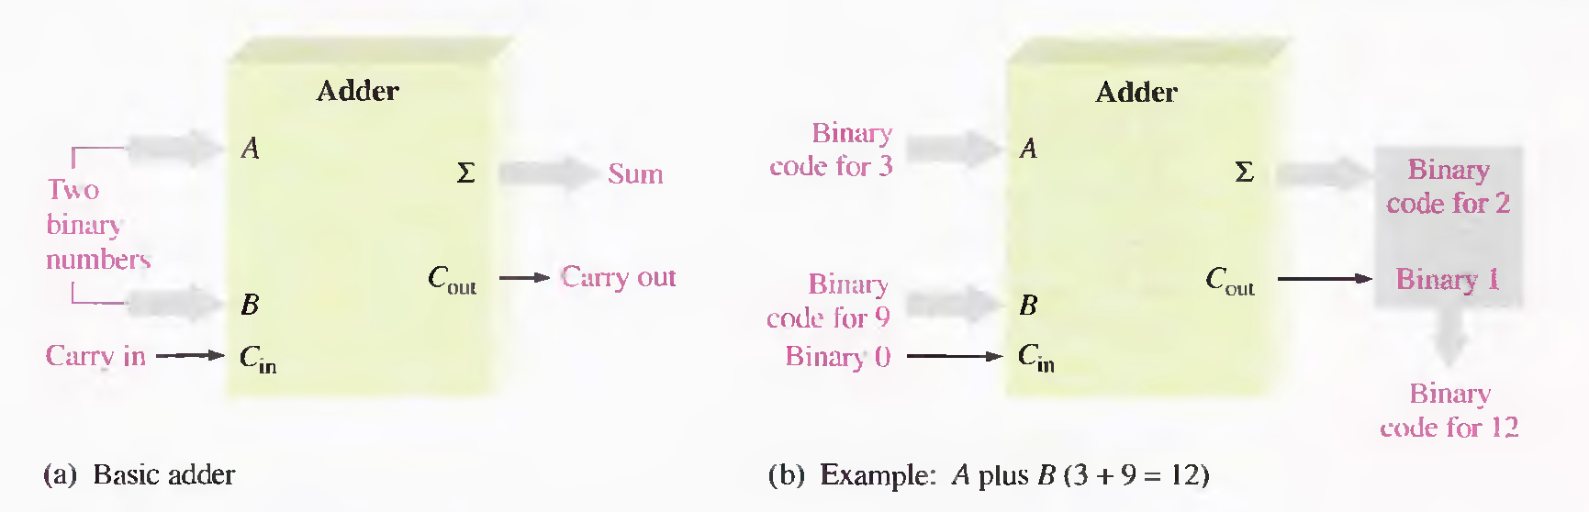
Introduction to the System Concept
Addition Subtraction Multiplication Division

Slide 30

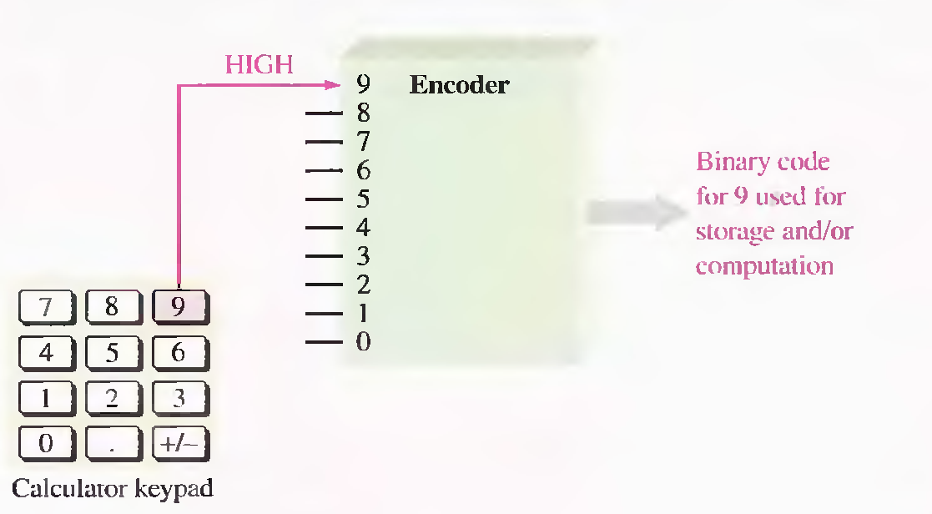
Code Conversion Function

Slide 31

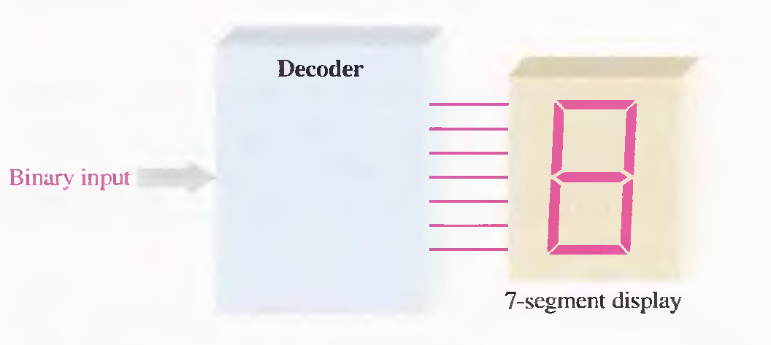
Code Conversion Function

Slide 32
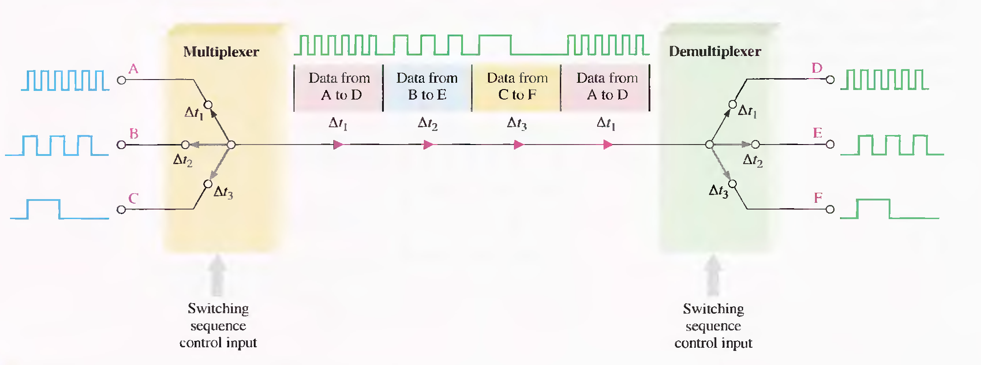
The Data Selection Function

Slide 33
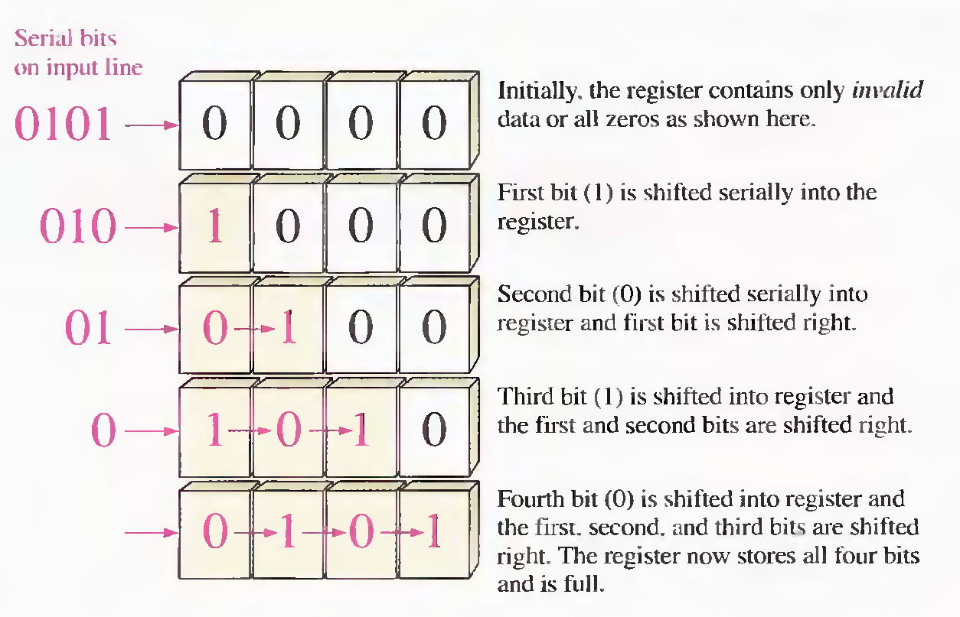
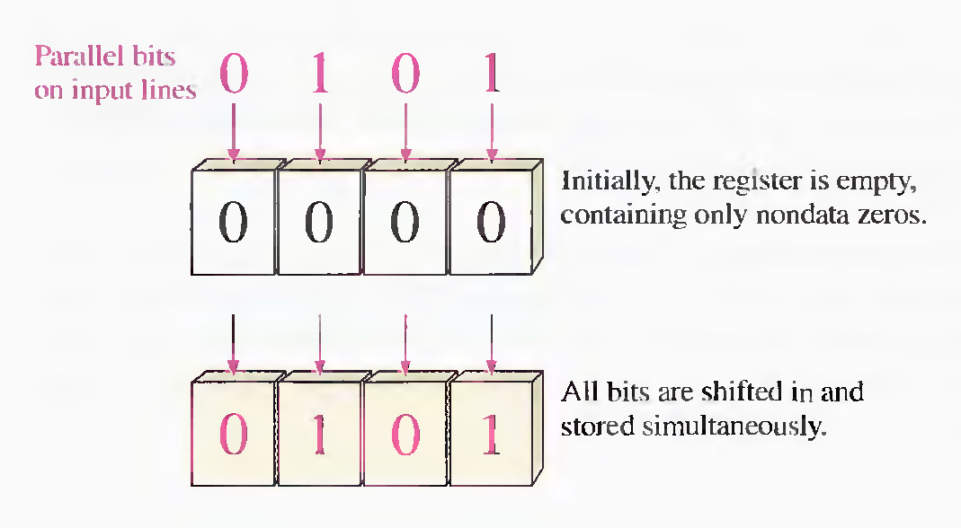
The Storage Function
Flip Flops
Registers
Semiconductor Memories
Magnetic Memories

Slide 34
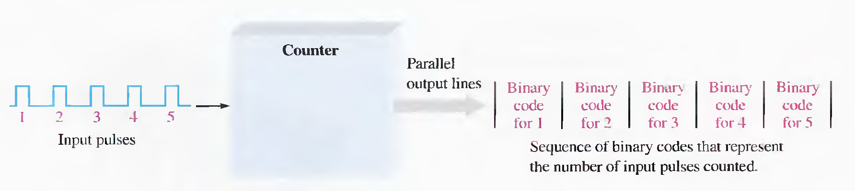
The Counting Function

Slide 35
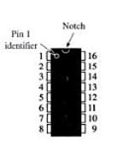
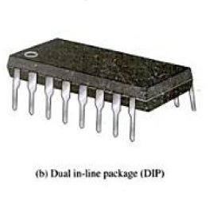
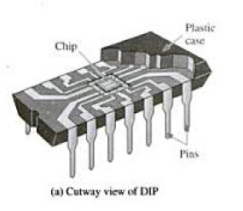
Digital Integrated Circuits
A monolithic integrated circuit (ICs)is an electronic circuit that is constructed entirely on a single chip of silicon. All components that make up the circuit—transistor , diodes, resistors and capacitors –are an integral part of that single chip.
The most common IC s fabrication technologies are :
CMOS ( complementary metal -oxide semiconductor )
TTL ( transistor - transistor logic )
NMOS ( N – channel metal -oxide semiconductor )
ECL (emitter- coupled logic )

